Slide 1
Helping Hand: Sprint 2
Helping Hand: Sprint 2
Piyusha Dongre, Chelsea Lau, Ysatis Tagle
Team 7
Piyusha Dongre, Chelsea Lau, Ysatis Tagle

Slide 2
Sprint 2 Goals
Decide on user input hardware and method
Research into actuators used in robotics hands and finger articulation
Begin brainstorming testing standards
Identify relevant open source software to use

Slide 3
Goal 1: User input
 | User Interaction | Design complexity | Reasoning
Direct Input | 4 | 2 | Accessible with right devices Lots of devices are proprietary Requires compatibility
External Processing | 3 | 4 | Accessible Library limited Open source, so easy to integrate
Myoelectric | 2 | 3 | Not open source Requires user to be able to move a certain way
[ 1 : least favorable, 5 : most favorable ]

Slide 4
Goal 2: Actuators
Actuators | Working | Advantages | Drawbacks
DC Motor | Rotary Motion | Most Common Reference materials available
Linear Motor | Push/ Pull
Servo Motor | Pick and Place |  | Not suitable for moving thumbstick / pressing buttons on controller
Springs | Storing energy (potential) | No electricity Muscles function as spring Individual finger movement can be accomplished
Solenoids |  |  | Limited stroke length Never been used in robotic fingers before
Pneumatic | Compressed air |  | Bulky Wheelchair recommended to store equipment
Notes:
Springs - Studies on the human muscle-tendon system have shown that muscles (including tendons and ligaments) function as a spring. More energy efficient if energy stored and released at a proper moment
Solenoid - Motions are yet to be driven directly by these
Haven't been used extensively to generate motions for the robotic fingers directly - a few papers where the outcome is solely based on mechanical theories or motional concept rather than on a working prototype
Pneumatic - BULKY : Require a compressor, storage tank, valves, transport air tubes, etc.
Recommended to use wheelchair where equipment is stored - not very suitable for this project

Slide 5
Actuators
Actuators | Working | Advantages | Drawbacks
Hydraulic | Incompressible liquid |  | More power Suitable in augmentation devices
Shape Memory Alloy (SMA) | Deformation of material |  | Safety concern
Feasible options - DC Motor, Linear Motor, Spring
Final decision depends on:
Game controller used
Mounting space
Weight
PWM or other serial communication
Notes:
Shape Memory Alloy - Works on the principle of deformation of the material.
Material expands and contracts due to heating and cooling at certain temperatures.
The material is usually made of a rod or wire type and is heated by applying a current through it.
The rods or wire also produce a lot of heat, and safety must be considered when this is to be used as a driving system for an exoskeleton.

Slide 6

Goal 3: Brainstorming Testing Standards
Project Definition: Develop a robot hand that is able to use a controller for the user
Key ideas: User stories
Accessible [hand free use]
Responsive [quick, compatible]
Articulate [detailed]

Slide 7
Brainstorming Testing
Design requirements: User stories + MVP
Accessible [hand free use]
Must be a hands free game interaction
Articulate [detailed]
Is able to move a joystick with variable force
Is able to pull a trigger and able to press a button
Doesn’t break controller
Responsive [quick, compatible]
Reliably reproduces above actions within a span of a 500ms

Slide 8
Brainstorming Testing
Requirement | Testing verification
Hands free game interaction | Complete X task only using designated user input
Move a joystick with variable force | Game performs X action
Pull a trigger and able to press a button | Game performs X action
Doesn’t break controller | Hand holds controller for 15 minutes without dropping Hand acts on controller for 15 minutes without dropping Force exerted by hand doesn’t exceed actuation force + 10%
Reliably reproduces above actions within a span of a 500ms | Game performs X Y Z within 500ms
Game dependent verification Arbitrary value, needs justification

Slide 9
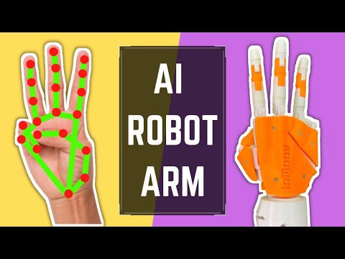
Goal 4: Open Source Software
Numerous OS projects that use accelerometer inputs to create gesture-controlled robots
Will not be using hand gestures but could use for head tilts for ex)
Waqar-107/Nymeria
Hand gesture controlled car
OpenCV
Open source computer vision and machine learning library
Can be used to translate user movements into robotic hand movements via camera and computer vision
Can also adapt this to head movements
Notes:
Researched different ways to convert an externally processed signal into robotic control
Narrowed down to the two that seemed to make the most sense for us
Going with OpenCV because of its popularity and widespread use - this allows for more available documentation/resources and reference material

Slide 10
Sprint 3 Goals:
Finalize testing standards [1]
Select input method for external processing [1]
Begin familiarization with relevant software libraries [2]
Choose microcontroller [2]
Create purchase list [1/2]
Document progress up to sprint 3 [1]

